Slide 1
Impact Analysis(Axillary Nodes) on Breast Cancer Early Deaths
Using Python Jupiter Notebook to perform EDA

Slide 2
Breast Cancer
Breast cancer is cancer that develops from breast tissue. Signs of breast cancer may include a lump in the breast, a change in breast shape, dimpling of the skin, fluid coming from the nipple, a newly inverted nipple, or a red or scaly patch of skin.
Symptoms: Lump in a breast, change in breast etc.,
Risk factors: Female, obesity, lack of exercise etc.,
Treatment: Surgery, radiation therapy, chemo etc.,
Diagnostic method: Tissue biopsy, scans etc.,
Lymph Nodes are small clumps of immune cells that act as filters for the lymphatic system. The lymphatic system runs throughout the body (like the circulatory (blood) system) and carries fluid and cells. If breast cancer spreads, the lymph nodes in the underarm (the axillary lymph nodes) are the first place it’s likely to go. The number of axillary lymph nodes can vary from person to person, ranging from 5 nodes to more than 30.Lymph node status is highly related to prognosis.
Lymph Node-negative means the axillary lymph nodes do not contain cancer.
Lymph Node-positive means the axillary lymph nodes contain cancer.

Slide 3
TNM staging system
TNM staging system The most commonly used tool that doctors use to describe the stage of the cancer. Doctors use the results from diagnostic tests and scans to answer these questions:
Tumor (T): How large is the primary tumor? Where is it located?
Node (N): Has the tumor spread to the lymph nodes? If so, where and how many?
Metastasis (M): Has the cancer spread to other parts of the body? If so, where and how much?
The “N” in the TNM staging system stands for lymph nodes.
Clinical staging: Evaluates the lymph nodes before the surgery, based on other tests and/or a physical examination.
Pathologic staging: Evaluates the lymph nodes after the surgery, which is a more accurate assessment.
NX: The lymph nodes were not evaluated.
N0: Either No cancer was found in the lymph nodes or Only areas of cancer smaller than 0.2 mm are in the lymph nodes.
N1: The cancer has spread to 1 to 3 axillary lymph nodes and/or the internal mammary lymph nodes.
N2: The cancer has spread to 4 to 9 axillary lymph nodes. Or it has spread to the internal mammary lymph nodes, but not the axillary lymph nodes.
N3: The cancer has spread to 10 or more axillary lymph nodes. Or it has spread to the lymph nodes located under
Pathological staging vs Positive axillary nodes
Positive Axillary Nodes # | Pathologic Stage
0-3 | N0
4-9 | N1
> 10 | N3

Slide 4
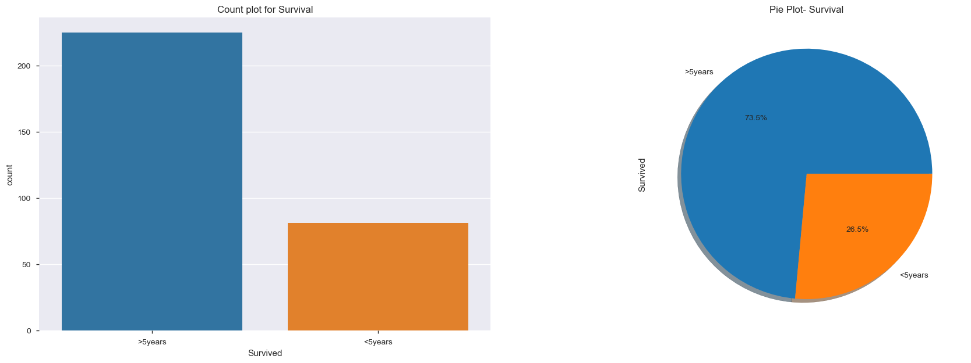
EDA –Analysis on Survivals > 5 years
Count and Pie plot shows more people survived > 5 years
Survived(225) after 5 years is more compare to died(81) before 5 years

Slide 5
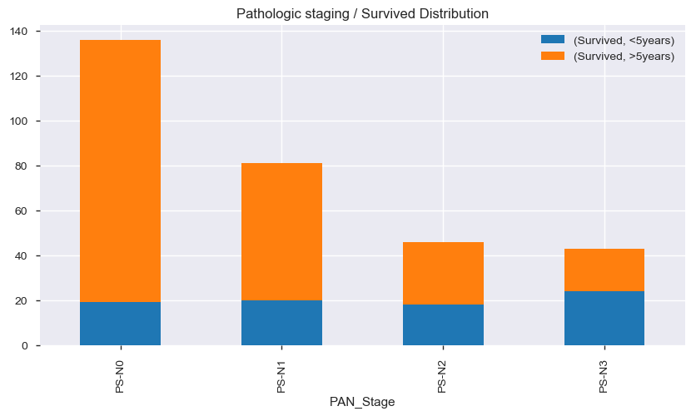
EDA –Analysis on Positive axillary nodes (Pathologic staging)
Bar Chart : Distribution of Survivals vs. Pathological staging
Key observations
When Staging = “N0” – Survived > 5 years is more
When Staging = “N3” – Survived > 5 years is less

Slide 6
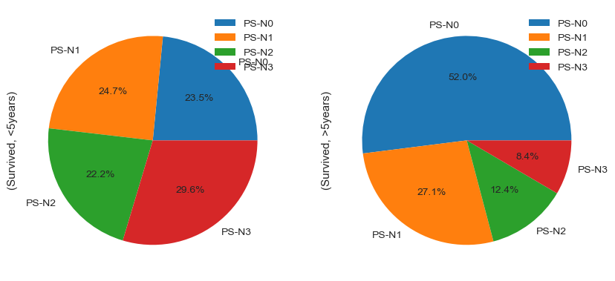
EDA –Analysis on Positive axillary nodes (Pathologic staging)
PIE Chart: Distribution of Survivals and Deaths vs. Pathological staging

Slide 7
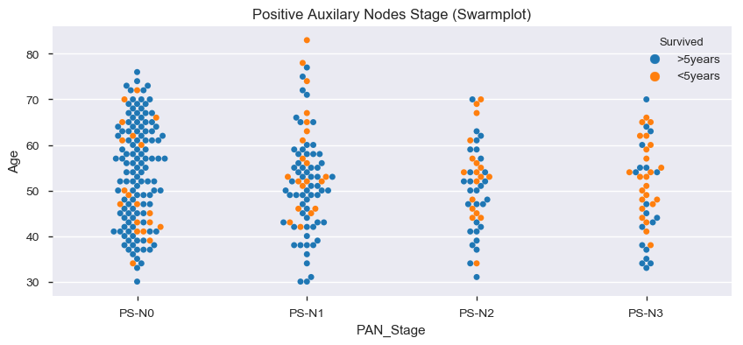
EDA –Analysis on Positive axillary nodes (Pathologic staging)
Swarm plot shows Survivals vs. Pathological staging
Key observations
When Staging = “N0” – Survived > 5 years is more (blue dots)
When Staging = “N3” – Survived > 5 years is less (orange dots)

Slide 8
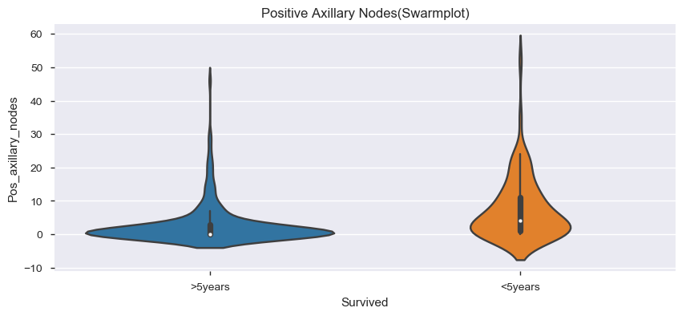
EDA –Analysis on Positive axillary nodes
Violin plot Survivals vs. Positive axillary nodes
Key observations
You can clearly observe that women who couldn't survive <5 years after operation was due to the contraction of high positive axillary lymph nodes which decreased the chances of their survival.

Slide 9
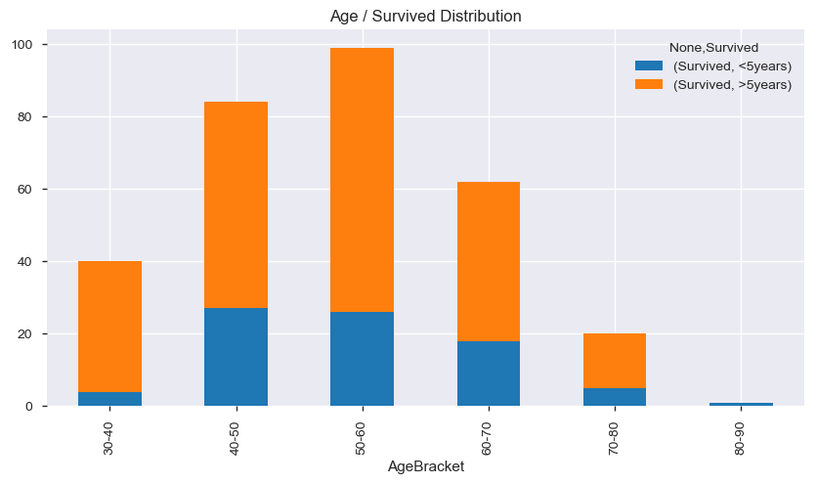
EDA –Analysis on Survivals vs. Age vs. Axillary nodes
Stacked bar plot Survivals vs. Age bracket
Key observations
There is no impact on Age for survivals

Slide 10
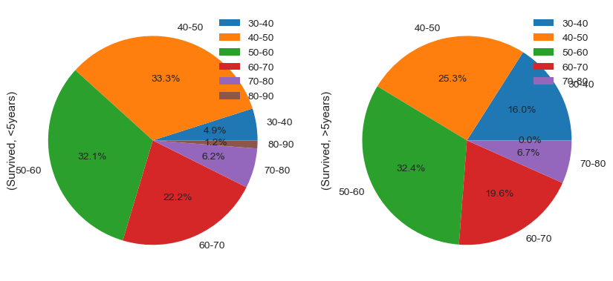
EDA –Analysis on Survivals vs. Age vs. Axillary nodes
PIE plot Survivals vs. Age bracket
Key observations
There is no impact on Age for survivals
65% of the age group falling under 40-60 were those who couldn't survive <5 years.
60% of the same age group were able to survive >5years.

Slide 11
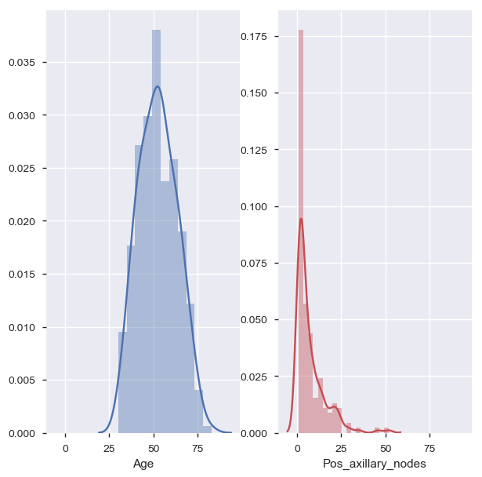
EDA –Analysis on Survivals vs. Age vs. Axillary nodes
Distribution Survivals vs. Age and survivals vs. Nodes
Key observations
Age is normally distributed
Positive axillary nodes is right skewed.

Slide 12
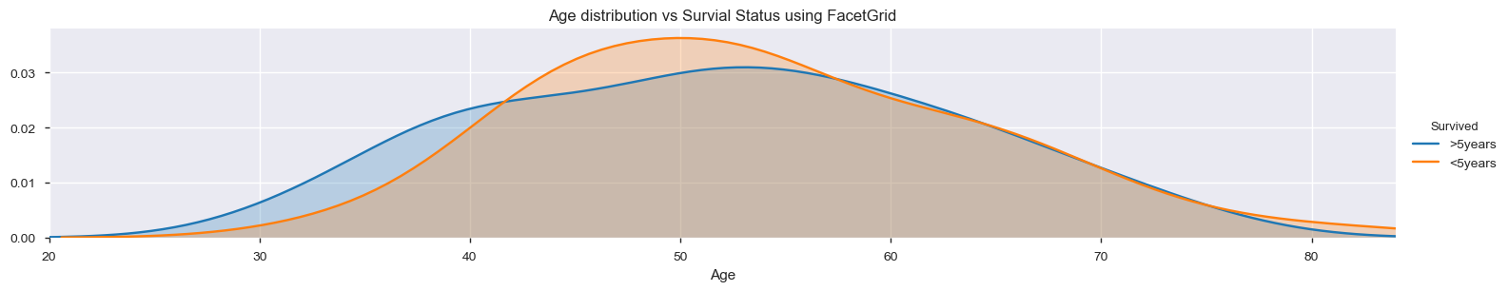
EDA –Analysis on Survivals vs. Age vs. Axillary nodes
Distribution Survivals vs. Age and survivals vs. Nodes
Key observations
Age is normally distributed between >5 years and <5 years survivals and the mean is around 50 years for both

Slide 13
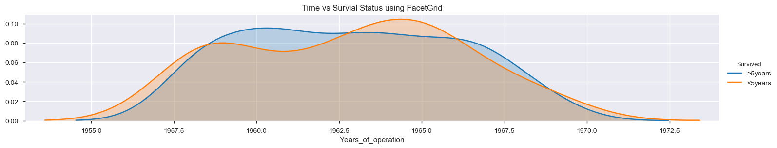
EDA –Analysis on Survivals vs. Year of operation
Distribution Survivals vs. Year of operation
Key observations
Majority of deaths happened between 1959 and 1966 after that there was declined due to good invention of better medications for both (<5 and >5)

Slide 14
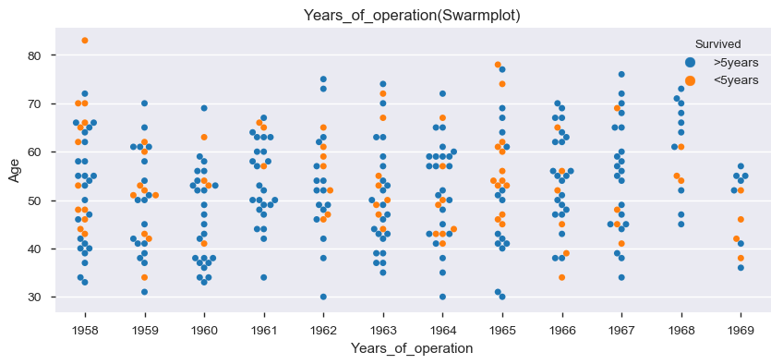
EDA –Analysis on Survivals vs. Year of operation
Distribution Survivals vs. Age and survivals vs. Nodes
Key observations
Majority of deaths happened between 1959 and 1966 after that there was declined due to good invention of better medications for both (<5 and >5)

Slide 15
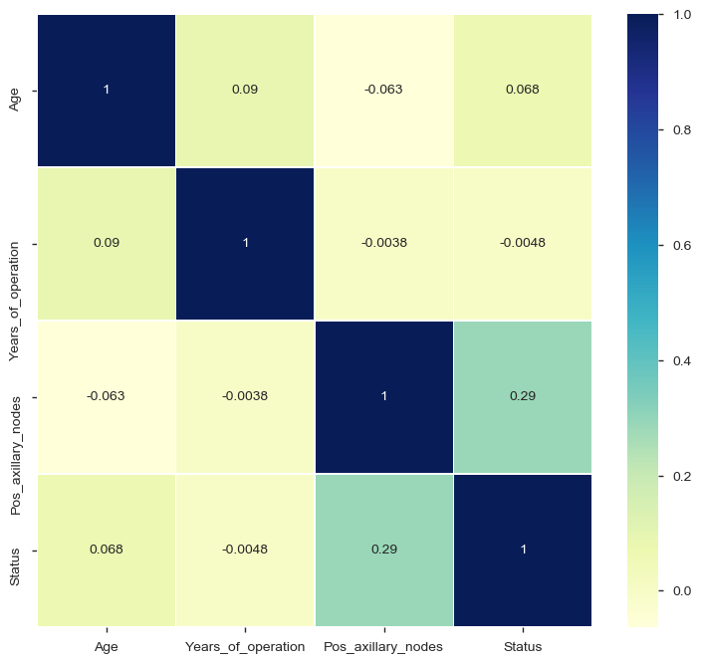
EDA –Analysis on correlations
Heat map: Relation of correlation between different parameters
Key observations
Age and Status less correlated
Nodes and Status are more positively co related

Slide 16
Hypothesis
More women with less axillary nodes are more likely to survive after 5 years

Slide 17
Thank You

